Slide 1

Item 8.4(1)/3 – Amendments to the Manual on the WIPPS (WMO-No. 485) for
water and related environmental prediction
Third Session of the Infrastructure Commission
(INFCOM-3, 15-19 April 2024)
David RICHARDSON / Chair SC-ESMP
17 April 2024

Slide 2

Doc.8.4(1) Amendments to the Manual on WIPPS
THREE draft Recommendations
Draft Recommendation 8.4(1)/1 – for weather prediction
  General WIPPS
  Global/Limited-area deterministic/ensemble NWP
Draft Recommendation 8.4(1)/2 – for climate prediction
  Sub-seasonal forecasts, Long-range prediction
  Annual to decadal prediction, global climate reanalysis
Draft Recommendation 8.4(1)/3 – for water and related environmental prediction
  Nuclear/non-nuclear environmental emergency response
  Marine emergency response, Global storm surge prediction
  Atmospheric sand and dust storm forecasts, Vegetation fire and smoke pollution forecasts

Slide 3
Doc.8.4(1) Amendments to the Manual on WIPPS
Draft Recommendation 8.4(1)/3 – for water and related environmental prediction
Update of Environmental Emergency Response activities
  Nuclear EER - Annex 1
    (1) improve temporal and spatial resolution in backward transport and dispersion products
    (2) add noble-gas-related products, and
    (3) change the request method from fax to email by both CTBTO and IAEA
  Non-nuclear EER: introduce a global arrangement - Annex 2
    RA VI‑designated RSMCs be responsible for RA I and RA II;
    RA IV‑designated RSMCs be responsible for RA III, RA V and the Antarctic
  Introduce the Regional Association as a responsible body in the designation of RSMCs conducting nuclear EER and non-nuclear EER - Annex 1 and 2

Slide 4
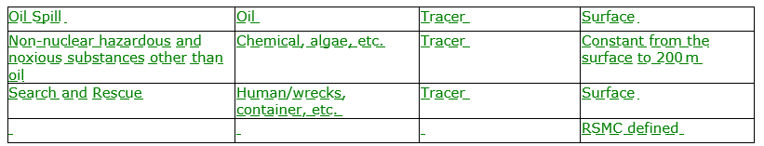
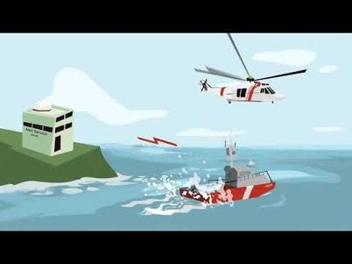
Doc.8.4(1) Amendments to the Manual on WIPPS
Draft Recommendation 8.4(1)/3 – for water and related environmental prediction
SERCOM invite INFCOM to consider at its 3rd session (SERCOM-3)
  Rename “marine environmental emergency response” and update the designation criteria of RSMC for marine emergency response - Annex 3
    Prepare, on request from an authorized person, MER analysis and forecast products
    Within one hour for a SAR event / four hours for a non-nuclear marine pollution, make available a range of products to the requester only in pre-agreed secured method
    Participate in MER testing exercises at the request of WMO or International Maritime Organization (IMO), and their Members/Member States, including national authorities

Slide 5
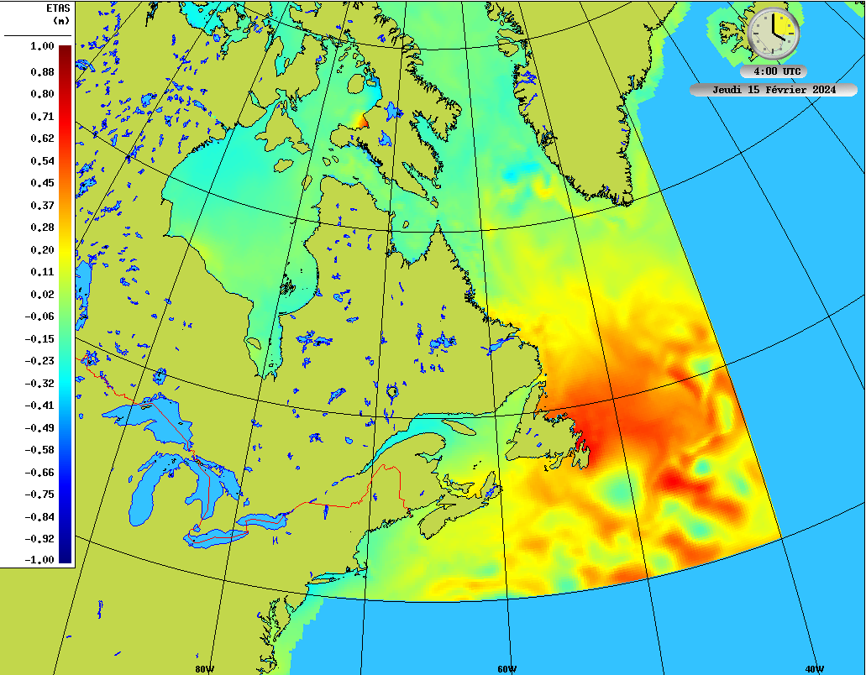
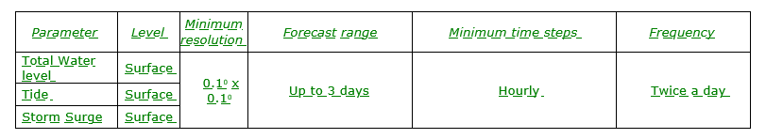
Doc.8.4(1) Amendments to the Manual on WIPPS
Draft Recommendation 8.4(1)/3 – for water and related environmental prediction
SERCOM invite INFCOM to consider at its 3rd session (SERCOM-3)
  The new designation criteria of RSMC for global numerical storm surge prediction as a general-purpose activity, - Annex 4
    Prepare as available global analyses, pseudo analyses or initial condition of variables contributing to ocean total water level;
    Prepare global forecast fields of basic and derived
    variables contributing to ocean total water level;
    Make available on WIS a range of these products;
    Prepare verification statistics and make them available
    Make available on a website up to date information

Slide 6
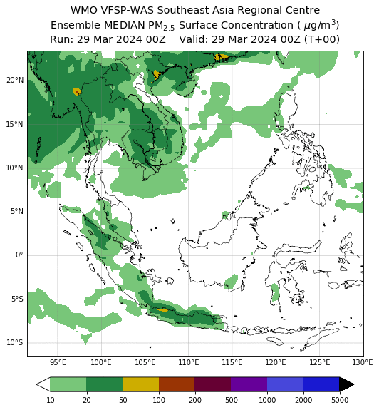
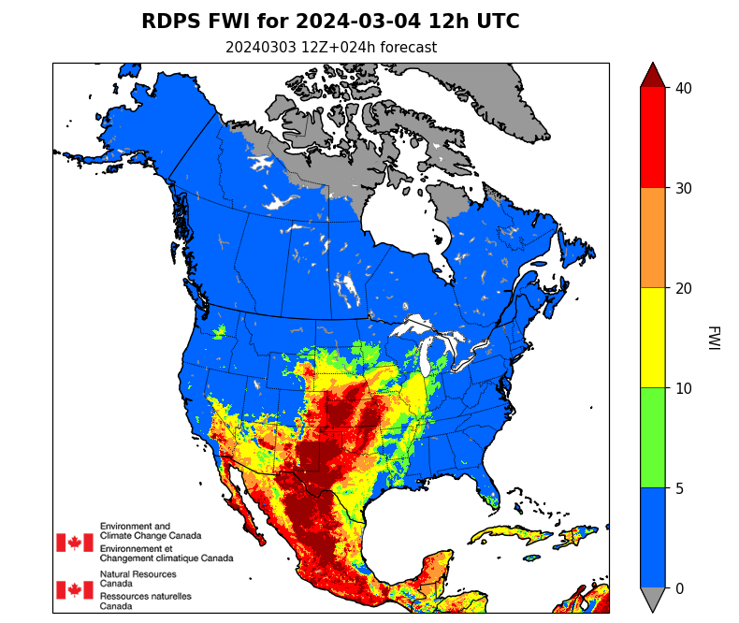
Doc.8.4(1) Amendments to the Manual on WIPPS
Draft Recommendation 8.4(1)/3 – for water and related
environmental prediction
Recommendation from Research Board (see INF 8.4(3))
  Establishment of “Vegetation fire and smoke pollution forecasts” as a new WIPPS activity for specialized purpose. - Annex 5
  Designation of Canada (ECCC) and Singapore (MSS) - Annex 6
PM2.5 surface concentration from
Southeast Asia Regional Centre - Singapore
Fire Weather Index (FWI) from
North American Regional Centre – Canada

Slide 7
draft Recommendation 8.4(1)/3
Contribution from Members
  Draft 2 – SERCOM
  Annex 3 to draft Resolution ##/3 (EC-78) – SERCOM
  All changes to Marine Emergency Response activity are made to align with the Decision 7/2 (SERCOM-3).

Slide 8
Thank you.
^{wmo.int}

